Slide 1

Infrastructure as a Service(IaaS)
Dr. Saroja Kumar Rout
Associate Professor, Depatment of IT

Slide 2
What is cloud infrastructure management?
Cloud infrastructure management comprises the processes and tools needed to effectively allocate and deliver key resources when and where they are required.
The UI, or dashboard, is a good example of such a tool; it acts as a control panel for provisioning, configuring and managing cloud infrastructure. Cloud infrastructure management is useful in delivering cloud services to both:
Internal users, such as developers or any other roles that consume cloud resources.
External users, such as customers and business partners.

Slide 3
Cloud Infrastructure Management
Cloud infrastructure consists of all of the hardware and software elements needed for cloud computing, including:
Compute (server)
Networking
Storage
Virtualization resources
Cloud infrastructure types usually also include a user interface (UI) for managing these virtual resources.

Slide 4
Infrastructure as a Service Providers
Iaas is also known as Hardware as a Service (HaaS). It is one of the layers of the cloud computing platform.
It allows customers to outsource their IT infrastructures such as servers, networking, processing, storage, virtual machines, and other resources. Customers access these resources on the Internet using a pay-as-per use model.
IaaS cloud computing platform layer eliminates the need for every organization to maintain the IT infrastructure.
IaaS is offered in three models: public, private, and hybrid cloud. The private cloud implies that the infrastructure resides at the customer-premise.
In the case of public cloud, it is located at the cloud computing platform vendor's data center, and the hybrid cloud is a combination of the two in which the customer selects the best of both public cloud or private cloud.

Slide 5
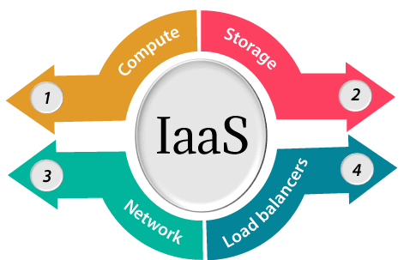
IaaS provider provides the following services -

Slide 6
IaaS provider provides the following services -
Compute: Computing as a Service includes virtual central processing units and virtual main memory for the Vms that is provisioned to the end- users.
Storage: IaaS provider provides back-end storage for storing files.
Network: Network as a Service (NaaS) provides networking components such as routers, switches, and bridges for the Vms.
Load balancers: It provides load balancing capability at the infrastructure layer.

Slide 7
Advantages of IaaS cloud computing layer
There are the following advantages of IaaS computing layer -
1. Shared infrastructure
IaaS allows multiple users to share the same physical infrastructure.
2. Web access to the resources
Iaas allows IT users to access resources over the internet.
3. Pay-as-per-use model
IaaS providers provide services based on the pay-as-per-use basis. The users are required to pay for what they have used.
4. Focus on the core business
IaaS providers focus on the organization's core business rather than on IT infrastructure.
5. On-demand scalability
On-demand scalability is one of the biggest advantages of IaaS. Using IaaS, users do not worry about to upgrade software and troubleshoot the issues related to hardware components.

Slide 8
Disadvantages of IaaS cloud computing layer
1. Security
Security is one of the biggest issues in IaaS. Most of the IaaS providers are not able to provide 100% security.
2. Maintenance & Upgrade
Although IaaS service providers maintain the software, but they do not upgrade the software for some organizations.
3. Interoperability issues
It is difficult to migrate VM from one IaaS provider to the other, so the customers might face problem related to vendor lock-in.

Slide 9
IaaS providers
1. Amazon AWS
2. DigitalOcean
3. Microsoft Azure
4. Rackspace Open Cloud
5. Google Compute Engine
6. HP Enterprise Converged Infrastructure
7. IBM SmartCloud Enterprise
8. Green Cloud Technologies
9. CloudStack
10. Linode
11. OpenStack
12. Cisco Cloud Infrastructure Solutions
13. CenturyLink Cloud
14. Joyent Triton
15. ProfitBricks
16. BlueLock

Slide 10
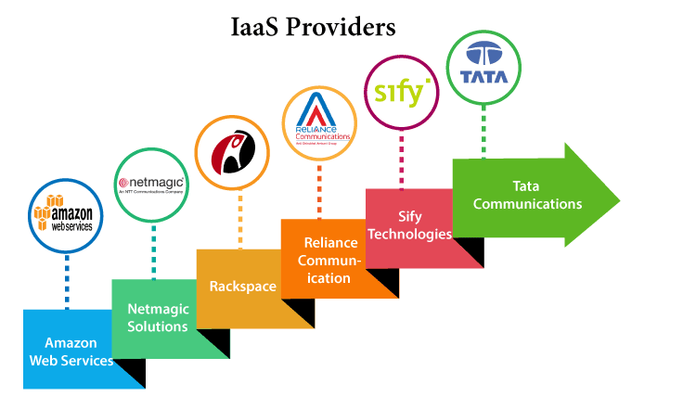

Slide 11
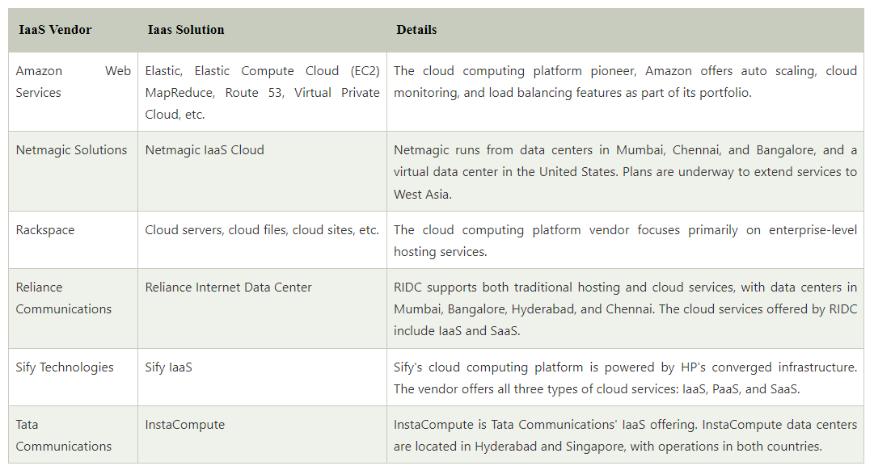

Slide 12


Slide 13


